Slide 1
Deploy your Acumatica Customizations with Confidence
Gabriel Michaud

Slide 2


Gabriel Michaud
Founder

Slide 3

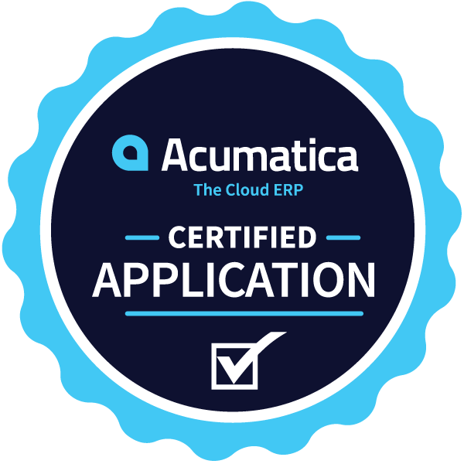
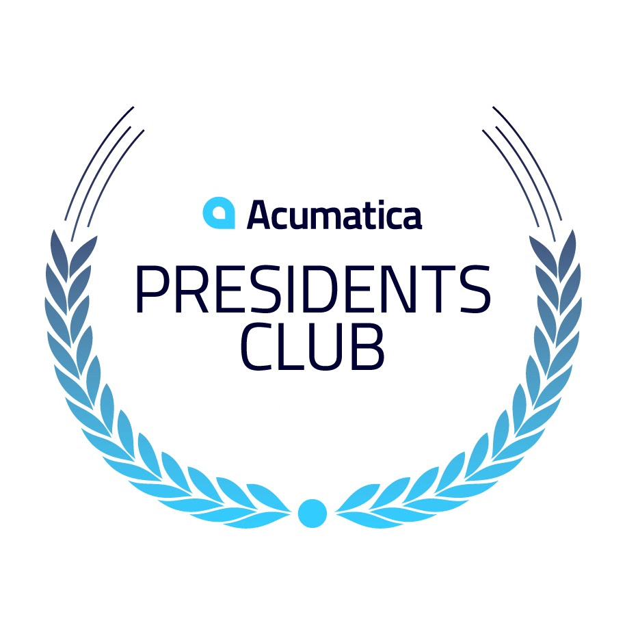


Lettie Wiemann
Controller, Vanguard Resources
“I love Velixo. It’s user-friendly and incredibly quick. I actually trust Velixo Reports and have piece of mind knowing I’m capturing everything since it’s integrated with Acumatica.”
Excel-based reporting for
5 min.
60+
Any Inquiry
650+
Unlimited
Time to install and build your first report
Exclusive Acumatica functions and tools designed for financial and project reporting
Works with *any* Acumatica Generic Inquiry
Happy Customers Worldwide
Number of users and installations included
Contact Info
info@velixo.com – velixo.com
Phone Number: (855) 5-VELIXO / (514) 360-5766

Slide 4

*** Live every 3rd Wednesday of the month at noon EST! ***

Slide 5
Agenda
Introduction
Why CI/CD?
Setting up your own CI/CD Pipeline for Acumatica Development Projects
Notes:
A quick survey before we get started
Who uses source control for their customization projects. If you’re not, please leave this session right away and start using one. I have accomplished my mission for you today!
Who uses the Acumatica Test SDK for UI Tests
Who does unit testing?
Who uses tools for automation of the test/build/deployment process?

Slide 6
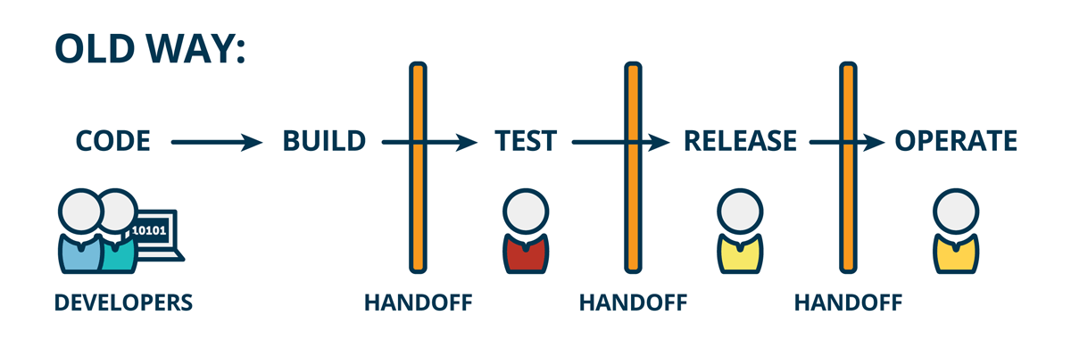

Traditional Software Development
Source: The Product Managers’ Guide to Continuous Delivery and DevOps
https://www.mindtheproduct.com/what-the-hell-are-ci-cd-and-devops-a-cheatsheet-for-the-rest-of-us/
Notes:
In traditional software development, the process of integration generally took place at the end of a project after each person had completed their work.
Integration generally takes days or weeks and can be painful.
Conflicts because two developers modified the same bit of code. Code that doesn’t compile. Things that were working previously and that no longer work. Code that doesn’t work in the production environment. Missing dependencies, etc.

Slide 7
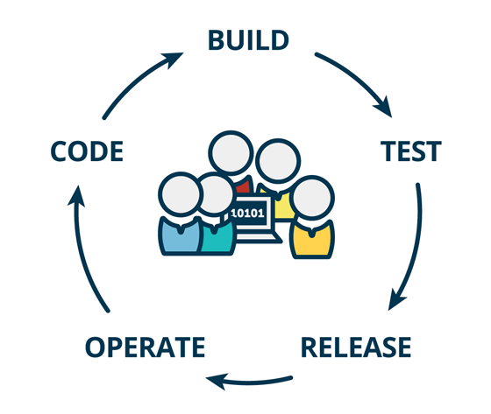
Enter Continuous Integration!
Source: The Product Managers’ Guide to Continuous Delivery and DevOps
https://www.mindtheproduct.com/what-the-hell-are-ci-cd-and-devops-a-cheatsheet-for-the-rest-of-us/
Notes:
Continuous integration is a practice that puts the integration phase earlier in the development cycle so that building, testing and integrating code happens on a more regular basis.

Slide 8
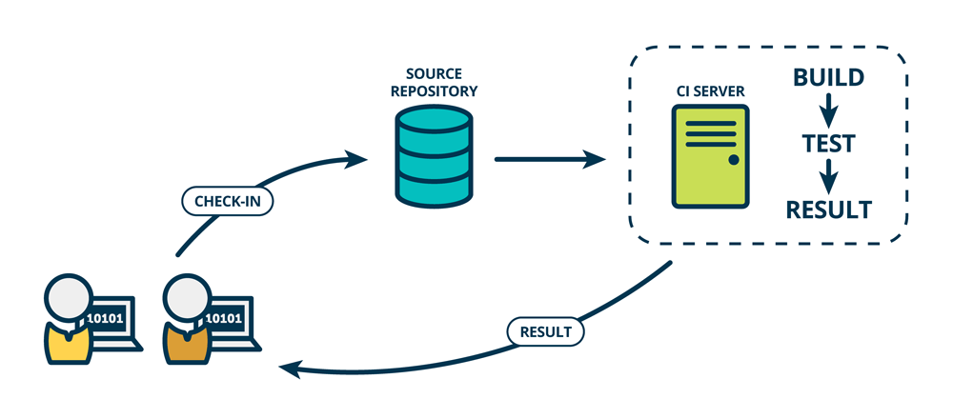
Continuous Integration
Continuous integration (CI) is a software development practice in which developers regularly integrate their code changes into a source code repository. To ensure that the new code does not introduce bugs, automated builds and tests run before or after developers check in their changes.
Source: The Product Managers’ Guide to Continuous Delivery and DevOps
https://www.mindtheproduct.com/what-the-hell-are-ci-cd-and-devops-a-cheatsheet-for-the-rest-of-us/
Notes:
CI means that one developer (let’s call him Steve!) who writes code on his laptop at home, and another dev (let’s call her Annie) who codes on her desktop in the office can both write software for the same product separately, integrate their changes together in a place called the source repository. They can then build the combined software from the bits they each wrote and test that it works the way they expect.
Developers generally use a tool called the CI Server to do the building and the integration for them. CI requires that Steve and Annie have self-testing code. This is code that tests itself to ensure that it is working as expected, and these tests are often called unit tests. When all the unit tests pass after the code is integrated Steve and Annie will get a green build. This indicates that they have verified that their changes are successfully integrated together, and the code is working as expected by the tests. However, while the integrated code is successfully working together, it not yet ready for production because it has not been tested and verified as working in production-like environments.
To be considered to be practising CI, Steve and Annie must check-in to the main source repository, integrate and test their code frequently and often. Usually many times an hour, but at a minimum once a day.
The benefit of CI is that integration becomes a non-event. Software is written and integrated all the time. Before CI, integration happened at the end of the creation process, all at once, and took an unknown amount of time; now with CI, it happens every day, takes minutes and is just “the way we work”.

Slide 9
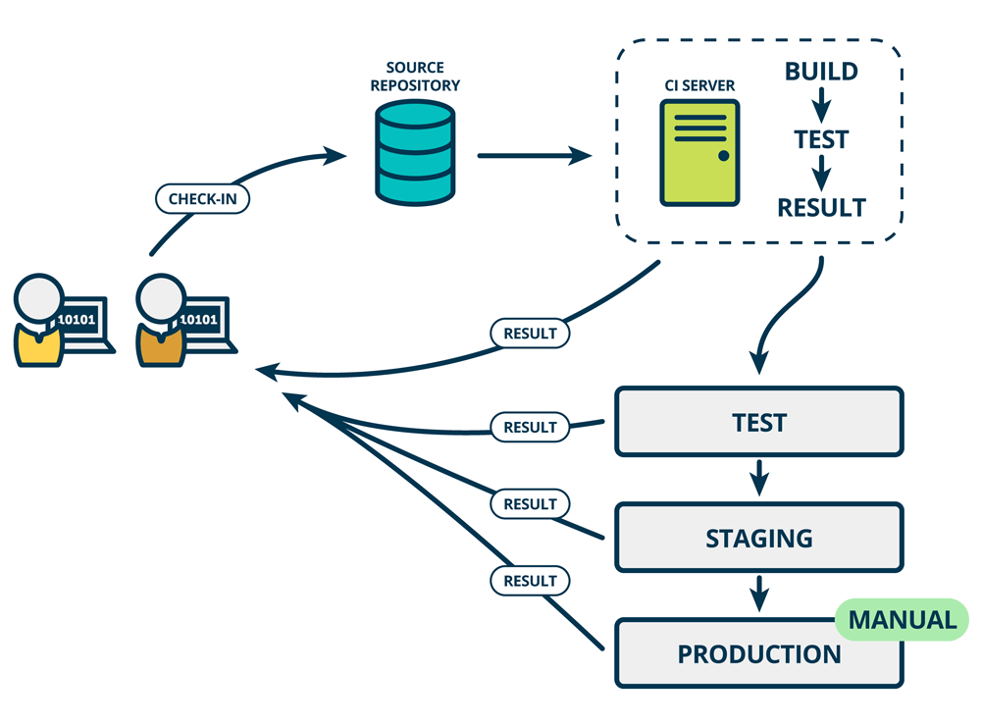
Continuous Delivery
Continuous Delivery (CD) is the ability to get changes of all types—including new features, configuration changes, bug fixes and experiments—into production, or into the hands of users, safely and quickly in a sustainable way.
Source: The Product Managers’ Guide to Continuous Delivery and DevOps
https://www.mindtheproduct.com/what-the-hell-are-ci-cd-and-devops-a-cheatsheet-for-the-rest-of-us/
Notes:
Continuous Delivery means that each time Steve or Annie makes changes to the code, integrates and builds the code, that they also automatically test this code on environments that are very similar to production. We call this progression of deploying to – and testing on – different environments a deployment pipeline.
Deployment pipelines often have multiple stages – these stages can vary by team, product or organization. For example at Velixo et have a development environment, a staging environment and a production environment.
In each different environment, the code that Annie or Steve wrote is tested differently. This gives more and more confidence to them, and to you, that the code will work on the production environment when the code is deployed there. Crucially, the code is only promoted to (tested on) the next environment in the deployment pipeline if it passes the tests of the previous environment. This way Annie and Steve get new feedback from the tests in each environment and, if there is a failure, they can understand more easily where the issue might be and get it fixed before the code gets to the production environment.

Slide 10
Coding Time!

Slide 11
Our Toolset
A GitHub repository with our Acumatica project and associated tests
A test Acumatica 2021 R2 instance
Azure Pipelines
Local build Azure Pipelines build agent
MSTest for unit/integration tests
Acumatica Test Framework (built on Selenium WebDriver)
Acumatica Unit Test libraries
Some duct tape!
Notes:
Explain why we need a local build agent

Slide 12
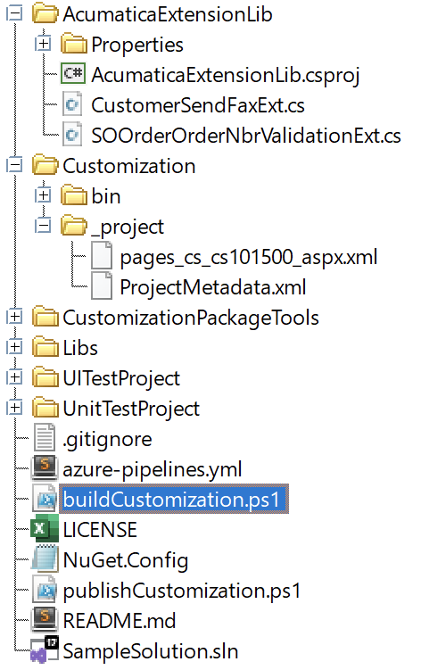
GitHub Repository Structure
github.com/VelixoSolutions/AcumaticaCIDemo/
Acumatica Extension Library
Post-build event copies DLL to customization project
Acumatica Customization Project
Saved using Source Control menu in customization project
Note: bin folder is not under source control – generated at build time
Command line app for packaging/publishing of customization + other
depencies required for unit testing
User Interface and Unit Test projects
Azure Pipelines YAML File
Script to build customization package
NuGet config to specify location of test SDK packages (not in online repo!)
Script to publish customization package

Slide 13
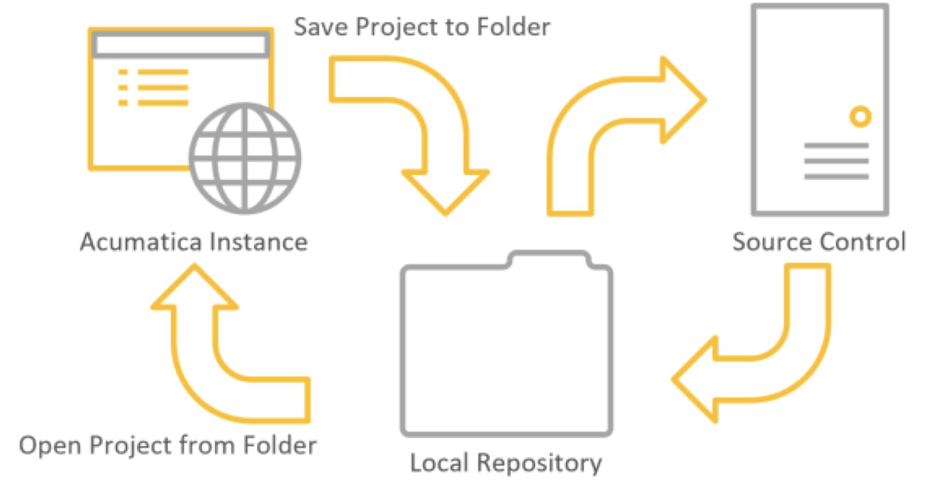
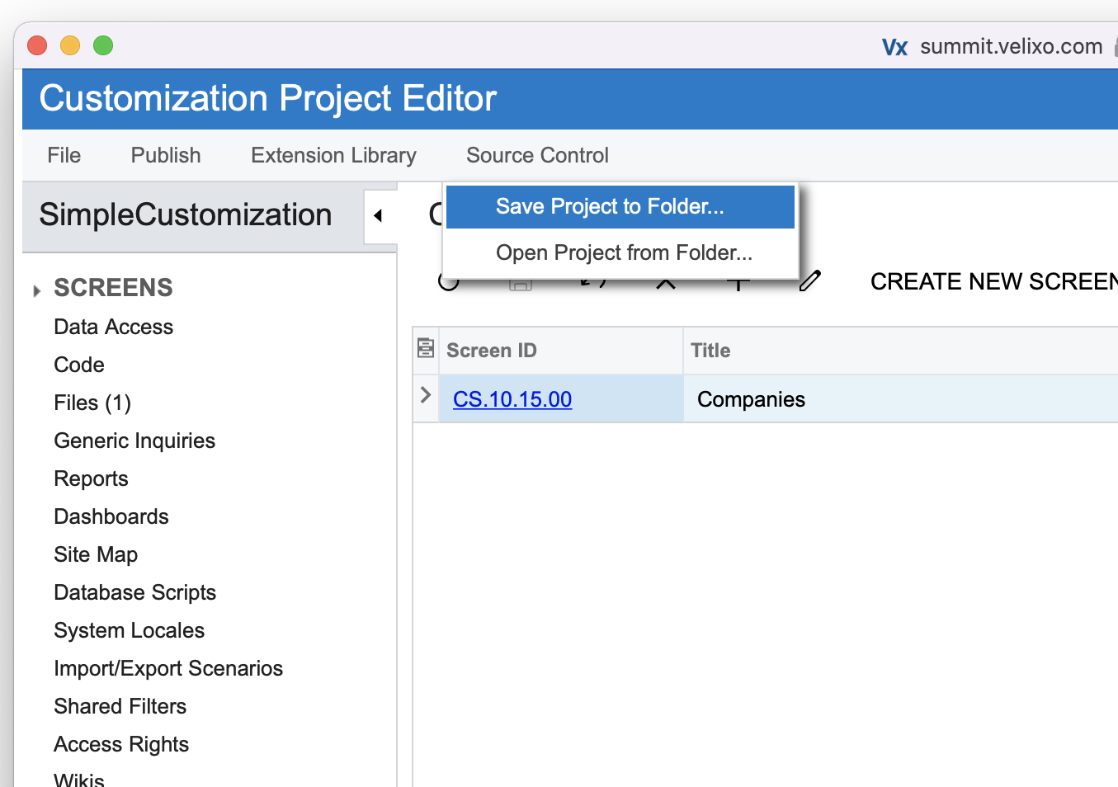
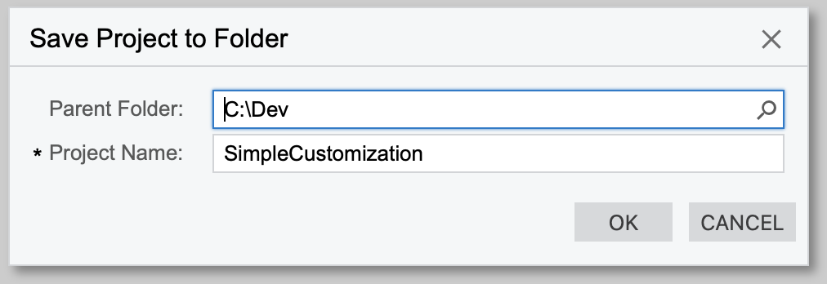
Acumatica Source Control Integration
Not a direct link to any specific source control tool
Read and write to a local folder
Use a local folder subscribed to source control
For more information, see “Source Code and Automation for Acumatica Developers” from the Acumatica Virtual Developer Conference 2019 Link: acumatica.com/media/2019/07/2019-Acumatica-DevCon-Source-Control-Automation.pdf
Notes:
Mention if there’s any Acumatica dev in the room – it always insist saving to a different path than the one you want.

Slide 14
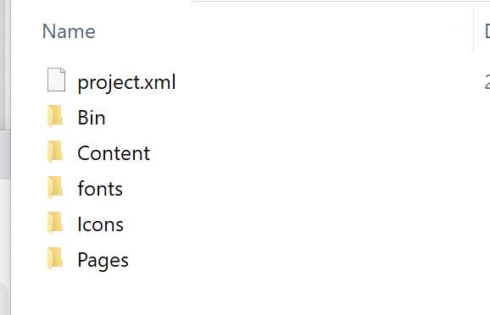
Building the Customization Package
What’s in a customization package?
PX.CommandLine.exe
Problem 1: Requires a full Acumatica ERP instance to build
Problem 2: Slow
Problem 3: Doesn’t seem to work at all when run in the context of a build agent
Is there an alternative? Let’s build one!
CustomizationPackageTools.exe build --customizationpath "Customization\" --packagefilename "Customization\SimpleCustomization.zip" --description "Simple customization project"

Slide 15
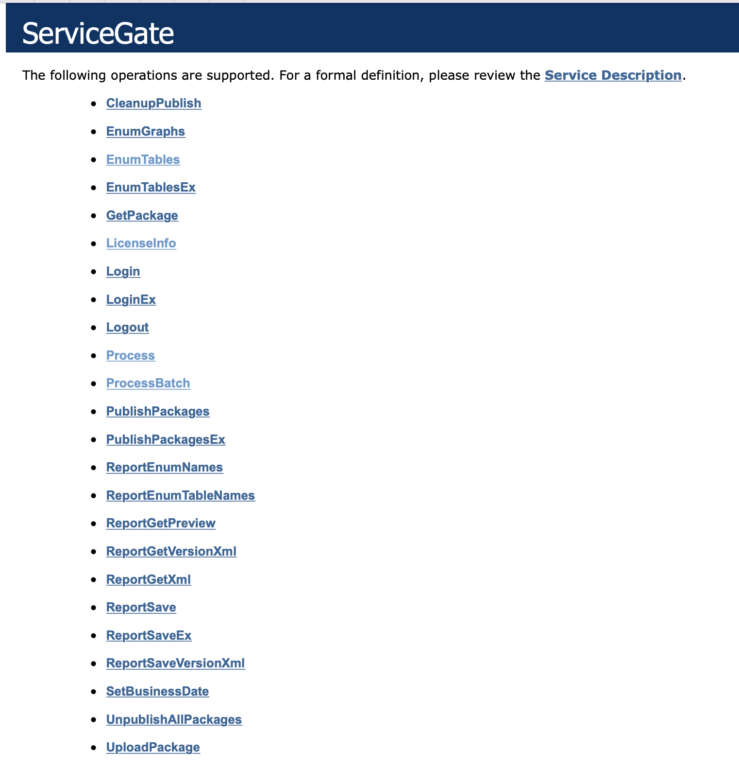
Publishing the Customization Package
Acumatica Service API at /api/ServiceGate.asmx (SOAP only!)
Azure Pipelines can’t call a web service API, but it can run any command-line app or PowerShell script
CustomizationPackageTools.exe publish --packagefilename "Customization\SimpleCustomization.zip" --packagename "SimpleCustomization" --url "https://summit.velixo.com" --username mylogin --password mypassword

Slide 16
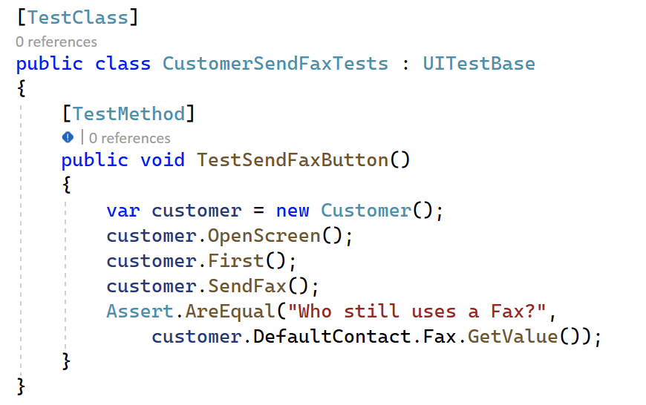
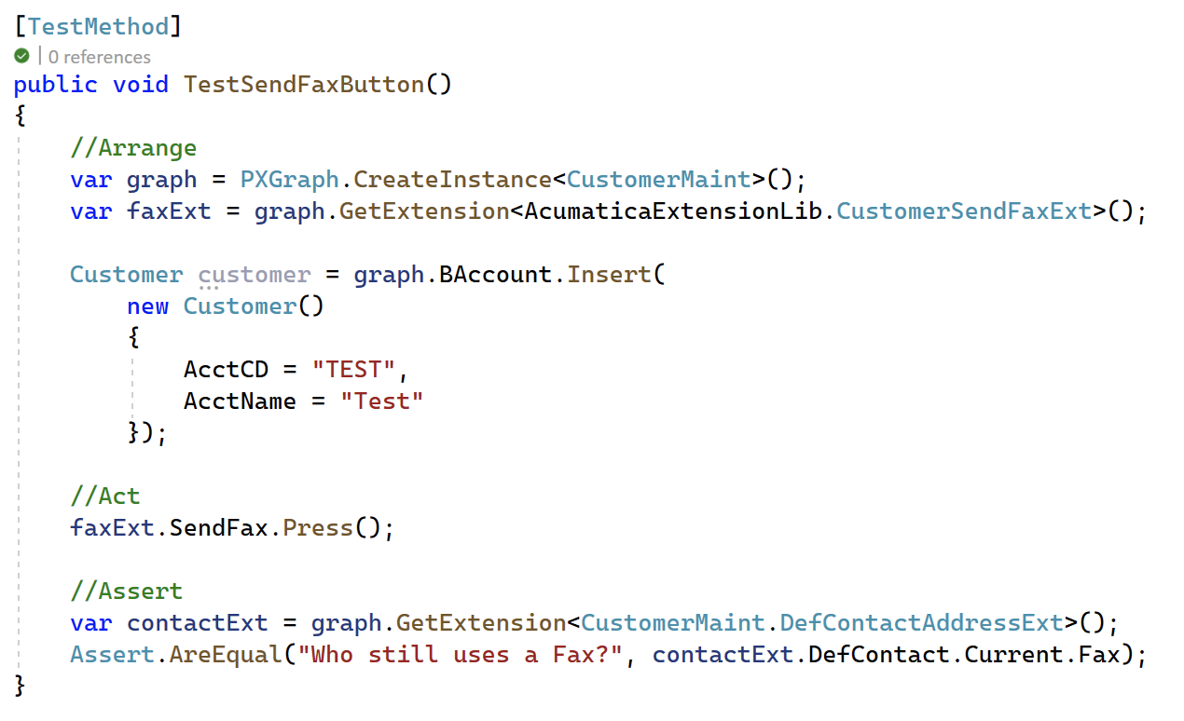
Testing - Taking Advantage of the Acumatica Testing Tools and Frameworks
User Interface Tests (Acumatica Test SDK)
Unit Tests (PX.Tests.Unit.dll)
Notes:
The UI test technically requires its own runne and logging infrastructure
In my case I wanted to be able to use it in MSTest (one could have used xUnit as well)

Slide 17
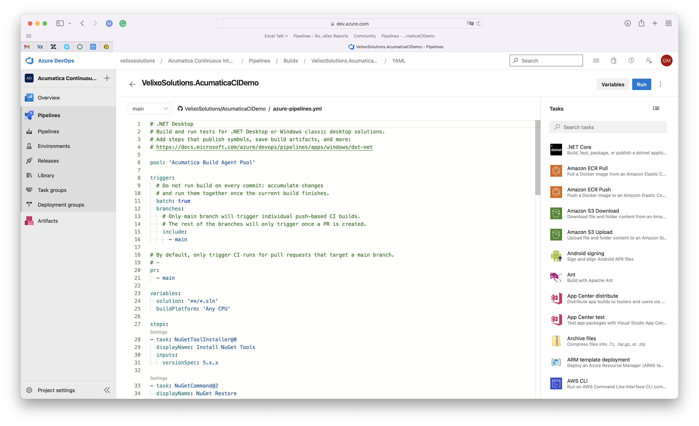
Putting it all Together – the Azure Pipeline YAML File

Slide 18
Let’s Try it Out!

Slide 19
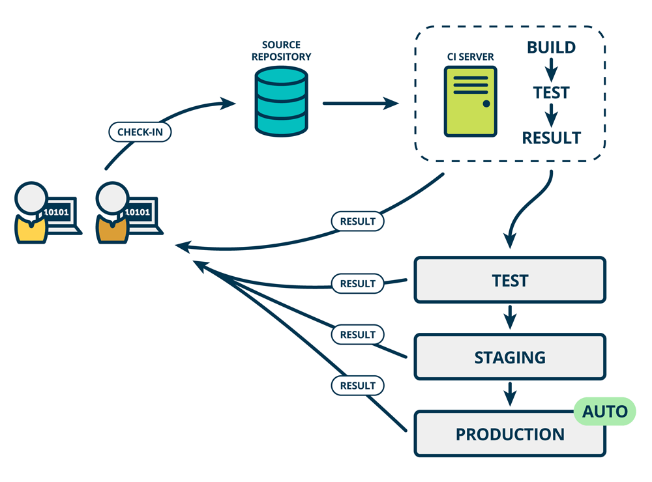
Taking it to the Next Level - Continuous Deployment
Source: The Product Managers’ Guide to Continuous Delivery and DevOps
https://www.mindtheproduct.com/what-the-hell-are-ci-cd-and-devops-a-cheatsheet-for-the-rest-of-us/
Notes:
This is a practice where every change that Steve or Annie makes, and which passes all the test stages, automatically goes to production.
Some companies do this and others do not. To achieve continuous deployment you first need to get to continuous delivery, so it’s not a priority to decide which is better for you until you’ve starting practicing continuous integration and continuous delivery.

Slide 20
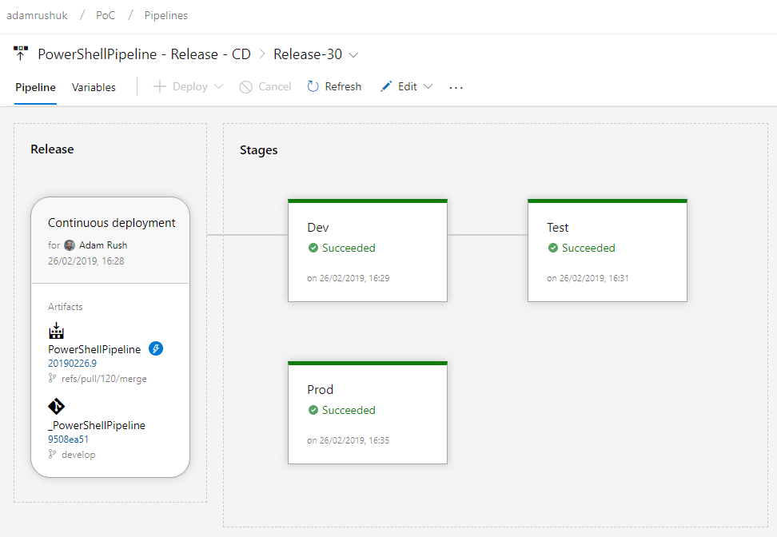
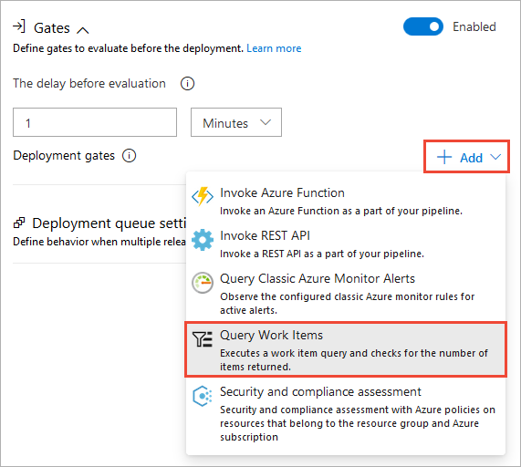
Azure Release Pipelines
Notes:
In Azure, you have something called Release Pipelines
You can define multiple stages, add gates – for example you could wait for 3 days after deployment to your staging environment, and if no new work items have been created you automatically deploy to production

Slide 21
Reference
The Product Manager’s Guide to Continuous Delivery and DevOps mindtheproduct.com/what-the-hell-are-ci-cd-and-devops-a-cheatsheet-for-the-rest-of-us/
Deploy an Azure Pipelines Agent on Windows docs.microsoft.com/en-us/azure/devops/pipelines/agents/v2-windows?view=azure-devops
Getting Started with Acumatica Test SDK (VLOG by Robert Waite, Acumatica MVP) youtube.com/watch?v=LiqTwe_Zhgk
GitHub repository used in this session: github.com/VelixoSolutions/AcumaticaCIDemo/
T280 DEVELOPMENT: TESTING BUSINESS LOGIC WITH THE ACUMATICA UNIT TEST FRAMEWORK 2021 R2 openuni.acumatica.com/courses/development/t280-development-testing-business-logic/

Slide 22
Notes:
Don’t let anyone fool you – it is hard!
Coordinating many people working on many things and running them all at the same time is hard
I hope I’ve been able to demystify CI/CD a bit and you found this useful.

Slide 23
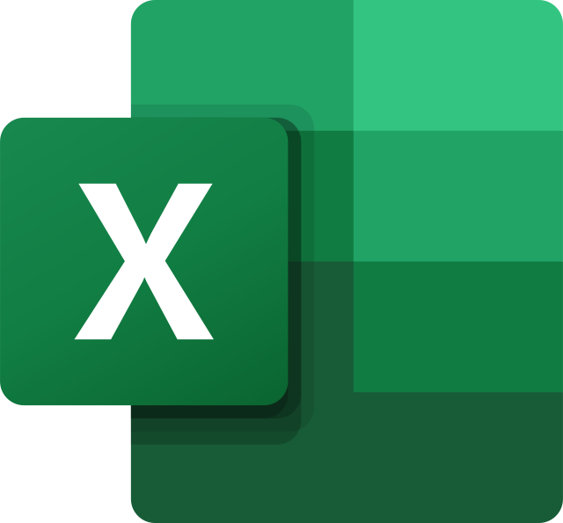

Don’t Miss my Other Breakout Session!
What: Making Magic with Excel and Acumatica - Featuring Mentalist/Magician Joe Skilton
When: Tuesday 2:15 PM
Where: Fleurie Room
With over one billion users, Excel is likely part of your daily arsenal. In this session, you will learn the secrets of Velixo, the leading Excel-based reporting solution for Acumatica. You, too, can become an Excel magician—and learn a real magic trick along the way.

Slide 24
Gabriel Michaud
gabriel@velixo.com
@gabrielmichaud

